Slide 1
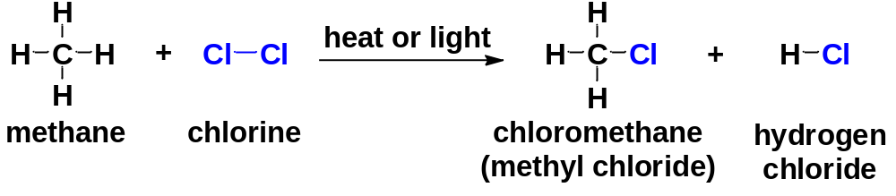
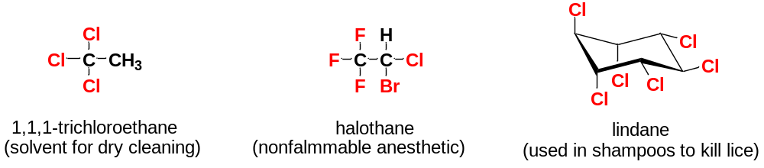
Chapter 7 Alkyl Halides:
Nucleophilic Substitution and Elimination
7-1 Introduction
An alkyl halide simply has a halogen atom bonded to one of the sp³ hybrid carbon atoms of an alkyl group.
Halogen atom is the functional group of alkyl halides.

Slide 2
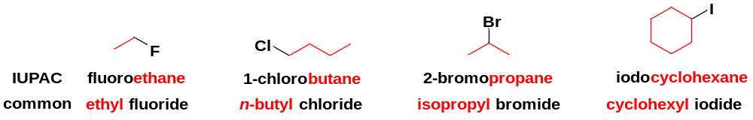
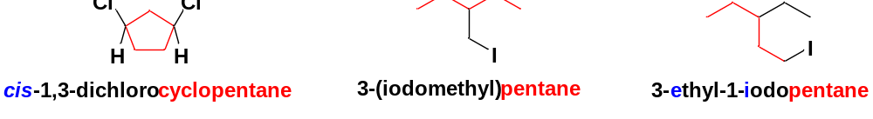
7-2 Nomenclature
7-2-1 Common or trivial names
Constructed by naming the alkyl group and then the halide.
This is the origin of the term alkyl halide.
Common names are useful only for simple alkyl halides.
7-2-2 The IUPAC nomenclature
Treating an alkyl halide as an alkane (base name) with a halo-substituent. The result is a systematic haloalkane name.

Slide 3
7-2-3 Special common names
A compound of formula CH₂X₂ is called a methylene halide.
A compound of formula CHX₃ is called a haloform.
A compound of formula CX₄ is called a carbon tetrahalide.

Slide 4
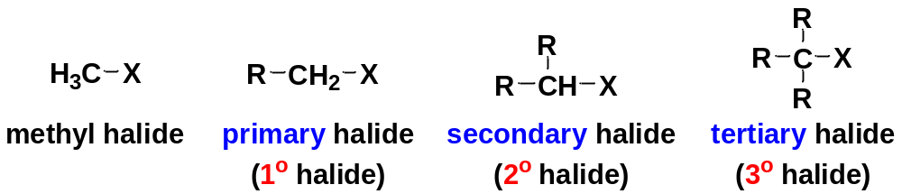
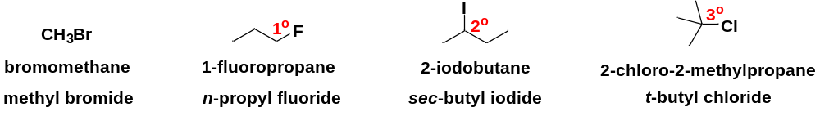
7-3 Classification
Alkyl halides are classified according to the nature of the carbon atom bonded to the halogen.
Methyl halide: the halogen-bearing carbon atom is a methyl group.
Primary halide: the halogen-bearing carbon is bonded to one carbon atom.
Secondary halide: two carbon atoms are bonded to the halogen-bearing carbon.
Tertiary halide: three other carbon atoms are bonded to the halogen-bearing carbon atom.

Slide 5
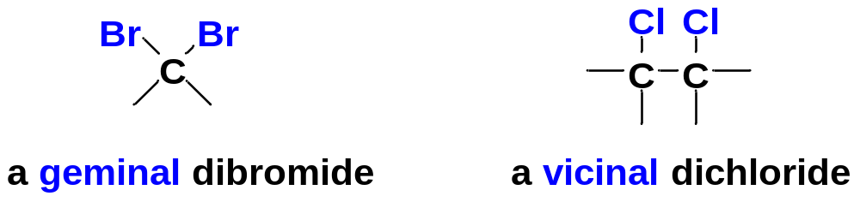
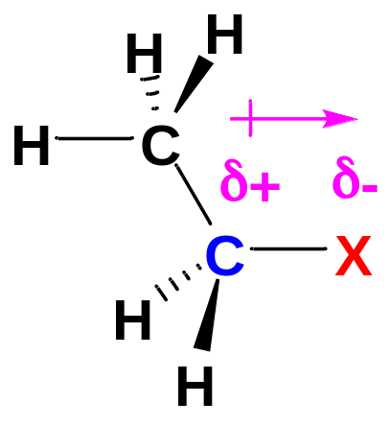
Geminal dihalide: the two halogen atoms are bonded to the same carbon atom.
Vicinal dihalide: the two halogens are bonded to adjacent carbon atoms.
7-4 Structure
In an alkyl halide, the halogen atom is bonded to an sp³ hybrid carbon atom
The C−X bond is polar, but the molecule as a whole may be polar or nonpolar.
Most reactions of alkyl halides result from breaking this polarized C−X bond

Slide 6
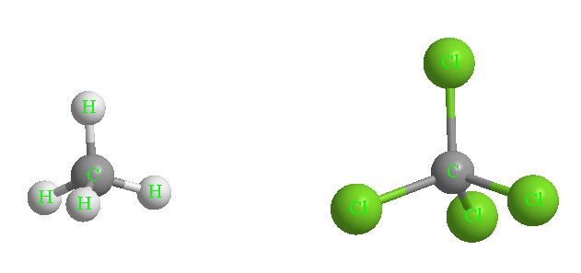
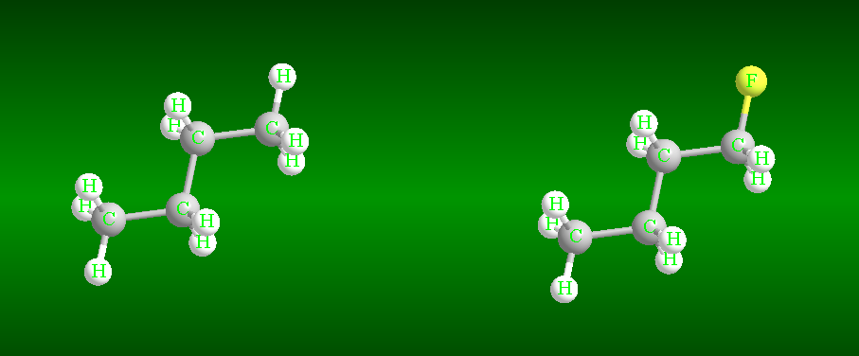
7-5 Physical Properties of Alkyl Halides
7-5-1 Boiling points
Two types of intermolecular forces influence the b.p. of alkyl halides: the London force and dipole-dipole attractions.
London forces are surface attractions, resulting from induced temporary dipoles of all molecules.
Molecules with larger surface areas have larger London attractions, resulting in higher boiling points.
CH₄ CCl₄
nonpolar molecule nonpolar molecule
b.p. -164 °C b.p. 77 °C
Dipole-dipole attractions in polar alkyl halides also affect the boiling points.
n-butane n-butyl fluoride
nonpolar molecule polar molecule
b.p. 0 °C b.p. 33 °C

Slide 7
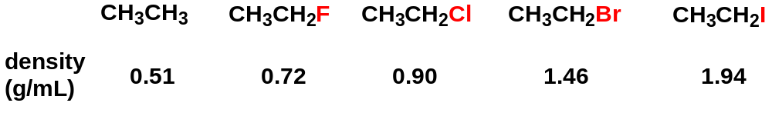
7-5-2 Densities
The presence of halogen atoms in alkyl halides increases their densities.
Alkyl chlorides with two or more chlorine atoms are denser than water.
All alkyl bromides and alkyl iodides are denser than water.
7-5-3 Solubilities
Alkyl halides are hydrophobic (or lipophilic). They do not dissolve in water, though most of them are polar molecules.
Alkyl halides are soluble in organic solvents such as alcohols, ethers and alkanes.

Slide 8
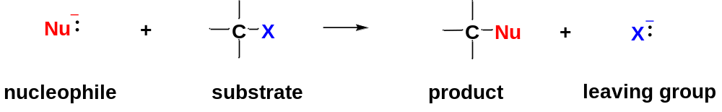
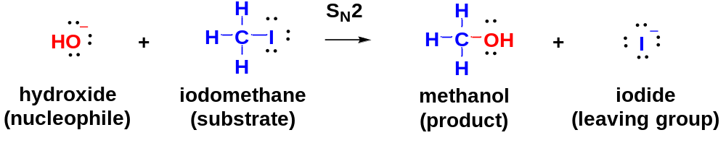
7-6 Second-Order Nucleophilic Substitution: The S_{N}2 Reaction
The general form of a nucleophilic substitution reaction:
δ+
Nucleophile: the species with unshared pairs of electrons or a negative charge.
Substrate: the compound (alkyl halide) that is attacked by the reagent. Alkyl halide is an electrophile in this reaction, because the carbon atom bonded to halogen is electrophilic, bearing a partial positive charge.

Slide 9
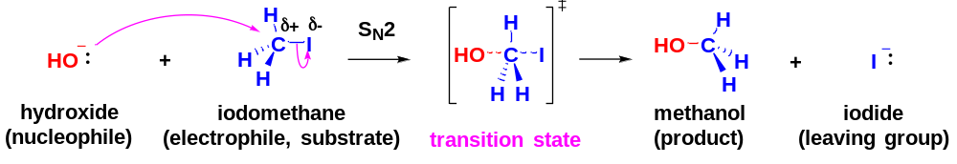
The S_{N}2 reaction takes place in a single (concerted) step.
In a concerted reaction, bonds break and form in a single step at the same time.
The middle structure of concerted reaction is called a transition state. It is not an intermediate, but an inseparable species existing for only an instant. In the transition state, the bond to the nucleophile is partially formed, and the bond to the leaving group is partially broken.
The reaction is first order in each of the reactants and second order overall:
rate = k[Nu:⁻][substrate]
The abbreviation S_{N}2 stands for Substitution, Nucleophilic, bimolecular.
In an S_{N}2 reaction, a nucleophile attacks the substrate (electrophile) from backside.
Notice that arrows are used to show the movement of electron pairs, from the electron-rich nucleophile to the electron-deficient carbon atom of the electrophile.

Slide 10
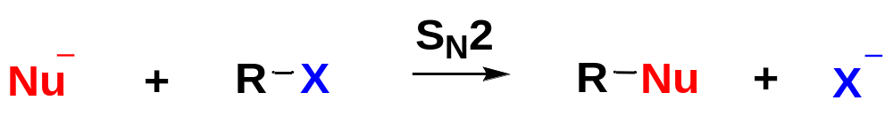
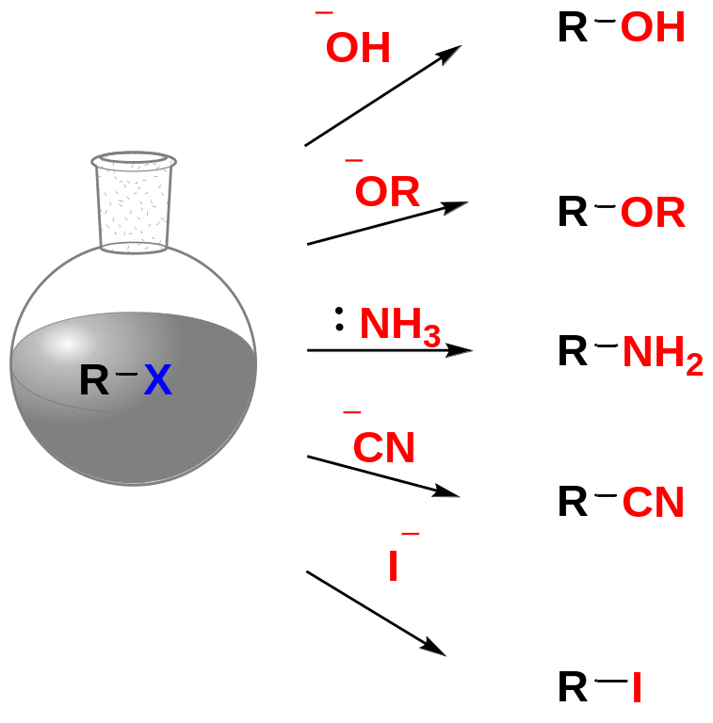
7-6-1 Generality of the S_{N}2 Reaction
Many useful reactions take place by the S_{N}2 mechanism.
Various nucleophiles are used to convert alkyl halides to a wide variety of functional groups.
Alcohol
Ether
Amine
Nitrile
Alkyl iodide

Slide 11
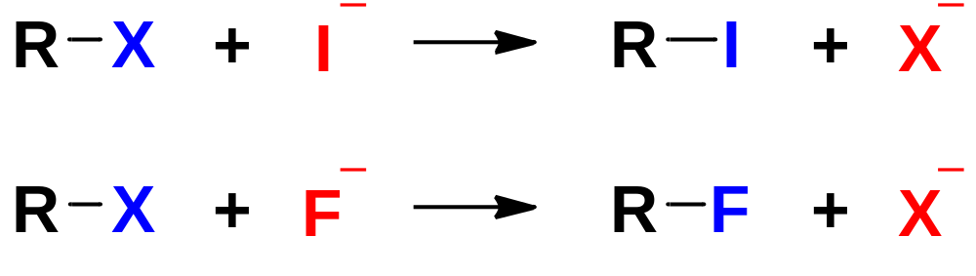
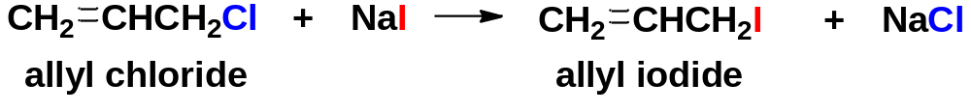
The S_{N}2 reaction provides a useful method for synthesizing RI （and RF）, which are more difficult to make than RCl and RBr.
Halides can be converted to other halides by halogen exchange reactions, in which one halide displaces another.

Slide 12
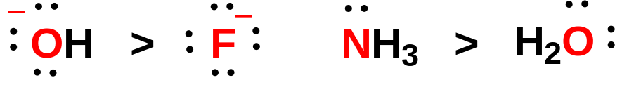
7-6-2 Factors Affecting S_{N}2 Reactions
Two main factors affect an S_{N}2 reaction: 1> the nucleophile; 2> the substrate (the alkyl halide).
1> Trends in the strength of nucleophiles
The nature of the nucleophile strongly affects the rate of the S_{N}2 reaction. A strong nucleophile is much more effective than a weak one in attacking an electrophilic carbon atom.
(1) A species with a negative charge is a stronger nucleophile than a similar neutral species. In particular, a base is a stronger nucleophile than its conjugate acid.
(2) Nucleophilicity decreases from left to right in the periodic table, following the increase in electronegativity from left to right. The more electronegative elements have more tightly held nonbonding electrons that are less reactive toward forming new bonds.

Slide 13
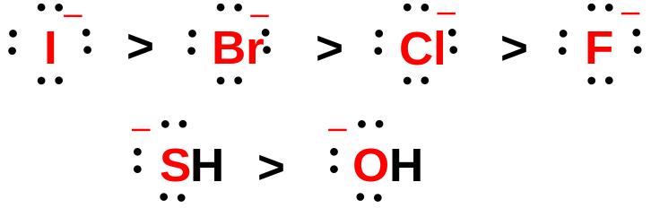
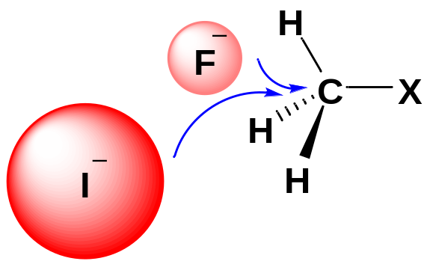
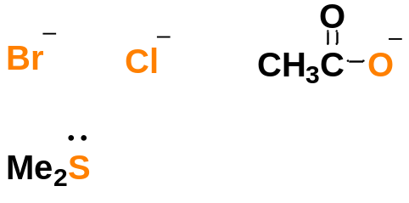
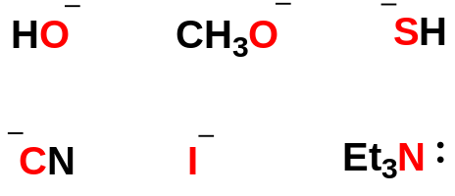

(3) Nucleophilicty increases down the periodic table, following the increase in size and polarizability.
As we go down a column in the periodic table, the atoms become larger, with more electrons at a greater distance from the nucleus. The electrons are more loosely held, and the atom is more polarizable. The increased mobility of its electrons enhances the atom’s ability to begin to form a bond at a relatively long distance.
Compared with F⁻, the atom of I⁻ is large.
The electrons in the outmost shell are loosely held, resulting in strong bonding ability.
Some common nucleophiles
Strong nucleophiles | Moderate nucleophiles | Weak nucleophiles

Slide 14
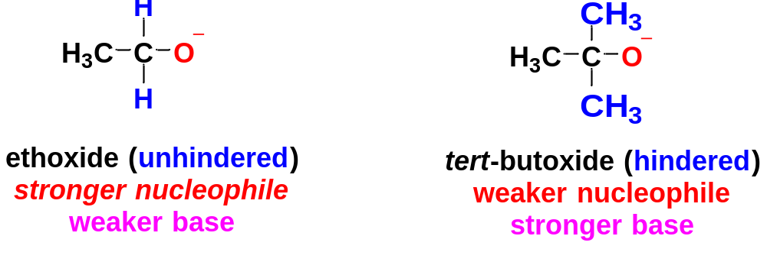
2> Steric Effects on Nucleophilicity
The S_{N}2 reactions are very sensitive to the bulkiness of the nucleophiles and substrates.
Bulky groups on the nucleophile hinder its close approach to the carbon atom of the electrophile, therefore they slow the reaction rate.
When bulky groups interfere with a reaction by virtue of their size, we call the effect steric hindrance.
Basicity is defined by the equilibrium constant for abstracting a proton.
Nucleophilicity is defined by the rate of attack on an electrophilic carbon atom.
Steric hindrance has little effect on basicity because basicity involves attack on an unhindered proton.
Steric hindrance has a great effect on nucleophilicity.
Most bases are also nucleophiles, capable of attacking either a proton or an electrophilic carbon atom.
If we want a species to act as a base, we use a bulky reagent like t-butoxide ion.
If we want it to react as a nucleophile, we use a less hindered reagent, like ethoxide.

Slide 15
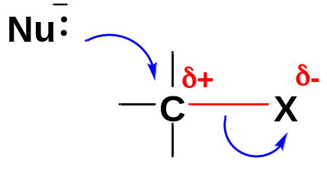
3> Reactivity of the Substrate in S_{N}2 Reactions
Just as the nucleophile is important in the S_{N}2 reaction, the structure of the alkyl halide is equally important.
To be a good substrate for S_{N}2 attack by a nucleophile, a molecule must have an electrophilic carbon atom with a good leaving group, and that carbon atom must not be too sterically hindered for a nucleophile to attack.
3A> Leaving-Group Effects on the Substrate
A leaving group serves two purposes in the S_{N}2 reaction:
(1) It polarizes the C-X bond, making the carbon atom electrophilic.
(2) It leaves with the pair of electrons that once bonded it to the electrophilic carbon atom.
To fill these roles, a good leaving group should be:
Electron withdrawing, to polarize the carbon atom.
Halogen atoms are strongly electronegative, so alkyl halides are common substrates for S_{N}2 reactions.
(2) Stable (not a strong base) once it has left.
Good leaving groups should be weak bases; therefore, they are the conjugate bases of strong acids. The hydrohalic acids HCl, HBr, HI are strong, and their conjugates (Cl⁻, Br⁻, and I⁻) are all weak bases. In contrast, HO⁻ and RO⁻ as strong bases are poor leaving groups for S_{N}2 reactions.

Slide 16
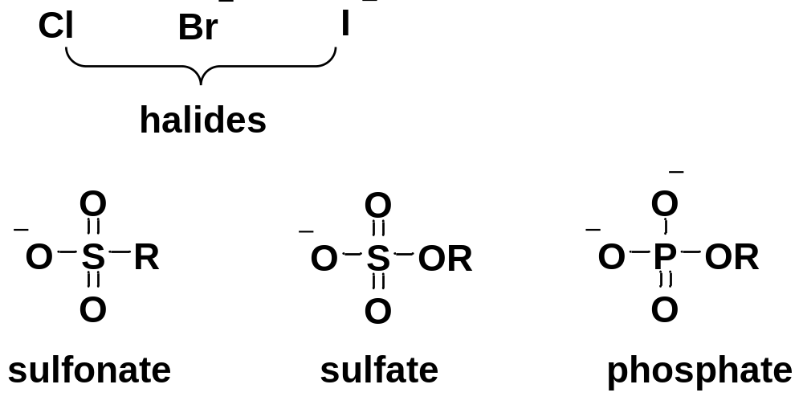
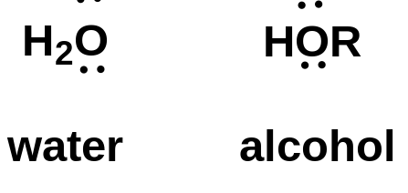
Weak bases that are common leaving groups
Ions | Neutral molecules

Slide 17
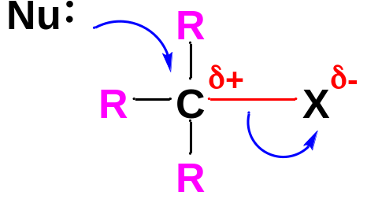
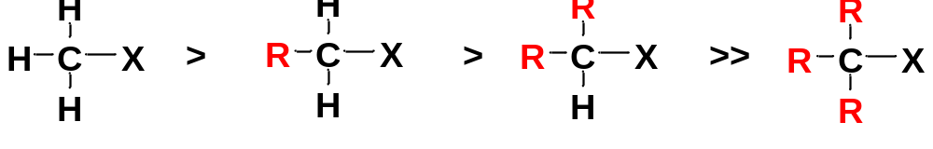
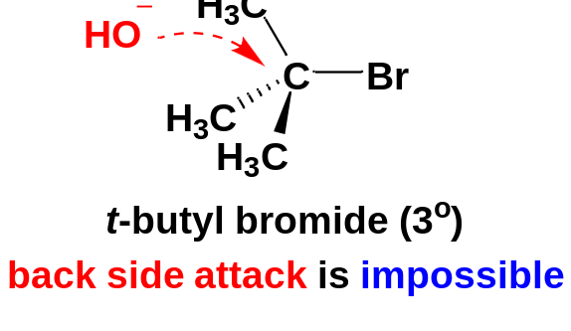
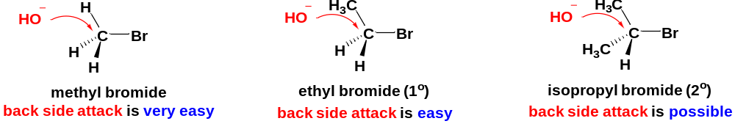
3B> Steric Effects on the Substrate
Different alkyl halides undergo S_{N}2 reactions at vastly different rates. The level of substitution on the electrophilic carbon atom greatly affects the reactivity toward S_{N}2 displacement .
The reaction goes rapidly with methyl halides and with most primary substrates. It is more sluggish with secondary halides.
Tertiary halides fail to react at all by the S_{N}2 mechanism.
For simple alkyl halides, the relative rates for S_{N}2 displacement are:

Slide 18
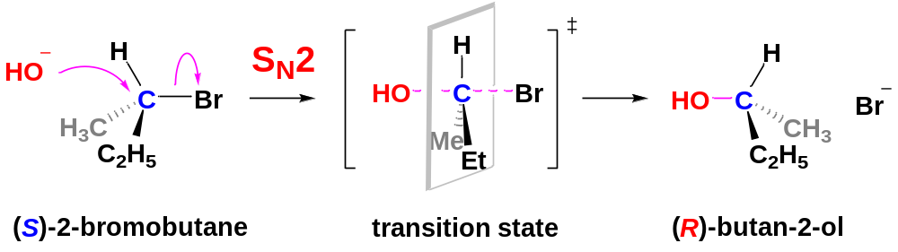
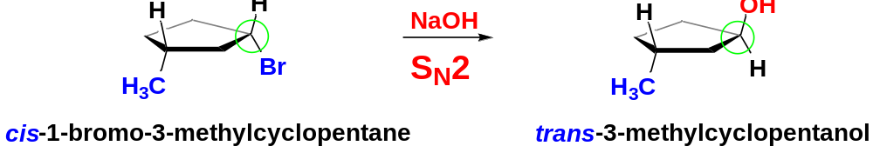
7-6-3 Stereochemistry of the S_{N}2 Reaction
The S_{N}2 reaction requires attack by a nucleophile on the back side of an electrophilic carbon atom.
Back-side attack turns the tetrahedron of the carbon atom inside out, like an umbrella caught by the wind.
In the product, the nucleophile assumes a stereochemical position opposite the position the leaving group originally occupied.
We call this result an inversion of configuration at the carbon atom.

Slide 19
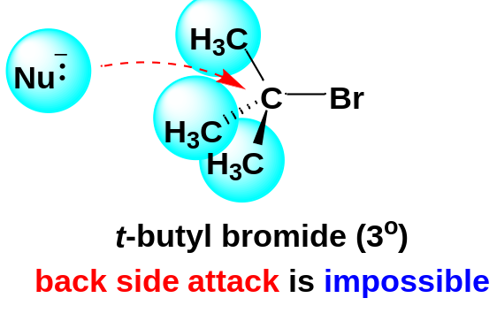
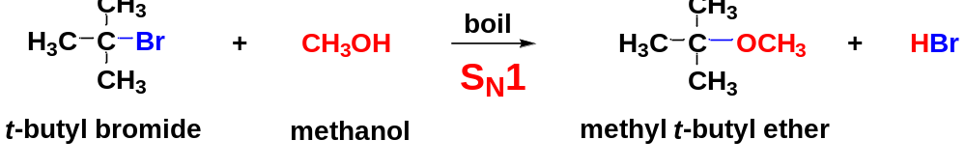
7-7 First-Order Nucleophilic Substitution: The S_{N}1 Reaction
t-Butyl bromide is a highly hindered tertiary halide, and therefore not a substrate for S_{N}2 reactions. However, it is a very good substrate for S_{N}1 reactions.
When t-butyl bromide is placed in boiling methanol, methyl t-butyl ether is produced. The reaction goes by the S_{N}1 mechanism.
The S_{N}1 reaction is first order overall: rate = k[(CH₃)₃CBr]. The rate does not depend on the concentration of the nucleophile CH₃OH.
The abbreviation S_{N}1 stands for Substitution, Nucleophilic, unimolecular.

Slide 20
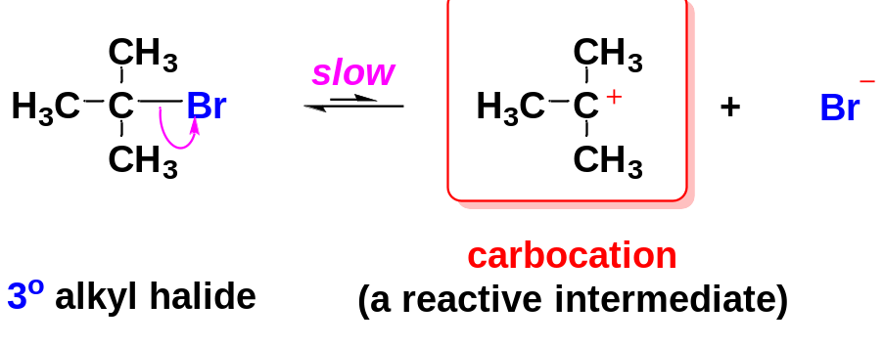
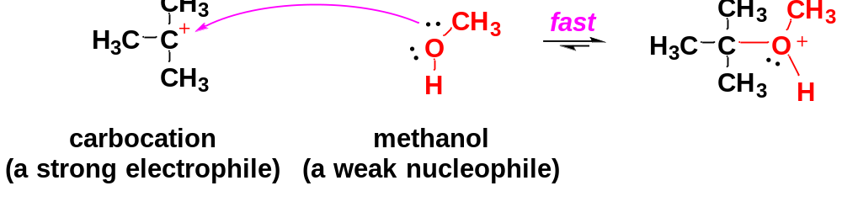
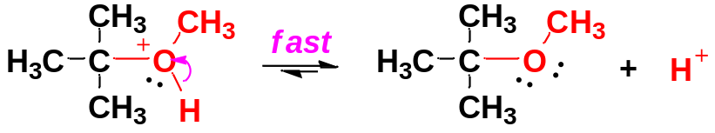
7-7-1 The mechanism of the S_{N}1 reaction
The S_{N}1 reaction of t-butyl bromide with boiling methanol involves 3 steps:
Step 1: Ionization of the alkyl halide to form a carbocation (slow, rate-limiting step).
The carbocation is a strong electrophile.
Step 2: A fast attack on the carbocation by the nucleophile CH₃OH.
Step 3: Loss of a proton to give the final uncharged product.

Slide 21
7-7-2 Substitution Effects and the relative stability of carbocations
The rate-limiting step of the S_{N}1 reaction is ionization to form a carbocation. Rates of S_{N}1 reactions depend strongly on carbocation stability.
Reactivity of alkyl halides toward S_{N}1 mechanisms follows the stability of carbocations: 3º > 2º > 1º > CH₃X.

Slide 22
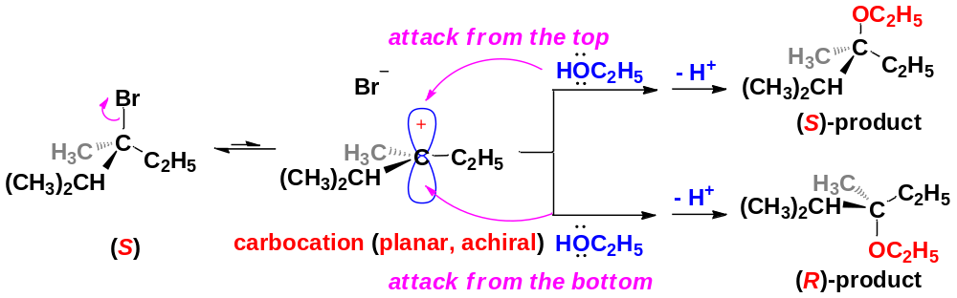
7-7-3 Stereochemistry of the S_{N}1 Reaction
retention of configuration
inversion of configuration
The S_{N}1 reactions of optically pure chiral substrate give both enantiomers of the product in equal amounts, which is called racemization.
In the S_{N}1 mechanism, the carbocation intermediate is sp² hybridized and planar.
The nucleophile attacks the carbocation both from the upper side and the lower side at equal odds, the product molecule shows retention of configuration and inversion of configuration at equal odds.

Slide 23
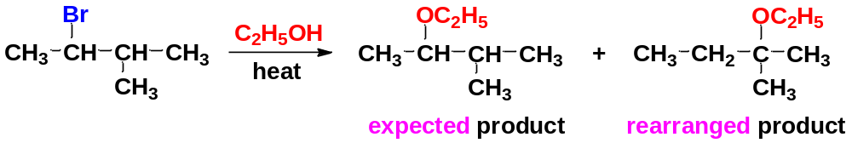
7-7-4 Rearrangement in S_{N}1 Reactions
Carbocations frequently undergo structural changes, called rearrangement, to form more stable cations.
A rearrangement may occur (1) after a carbocation has formed or (2) it may occur as the leaving group is leaving.
Rearrangements are seen in S_{N}1 reactions. An example of a reaction with rearrangement is the S_{N}1 reaction of 2-bromo-3-methylbutane in boiling ethanol.
The product is a mixture of 2-ethoxy-3-methylbutane (not rearranged) and 2-ethoxy-2-methylbutane (rearranged).

Slide 24
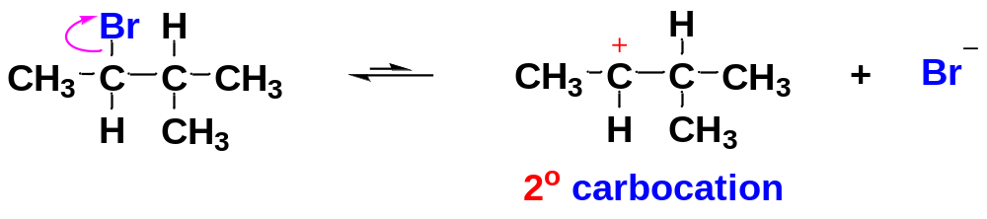
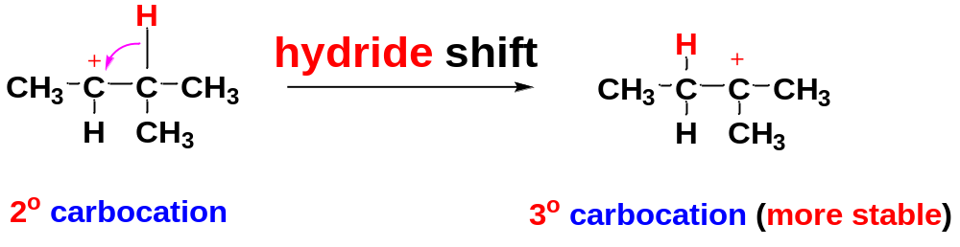
Mechanism:
Step 1: Unimolecular ionization gives a carbocation.
Step 2: A hydride shift forms a more stable carbocation (driving force).
This hydrogen moves with pair of electrons

Slide 25
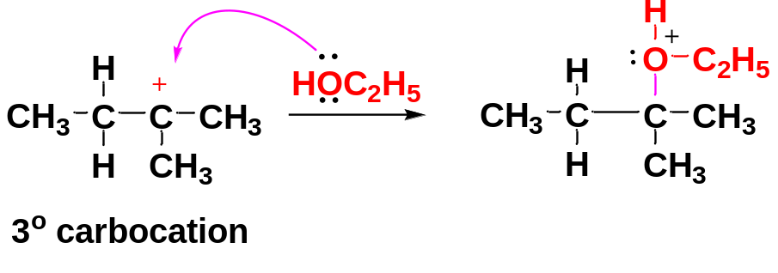
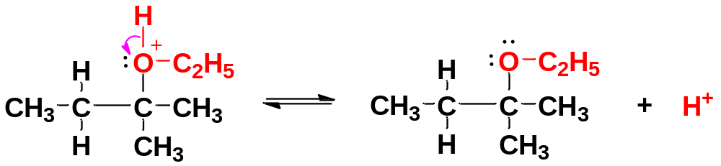
Step 3: A weak nucleophile (solvent here) attacks the rearranged carbocation.
Step 4: Deprotonation gives the rearranged product.

Slide 26
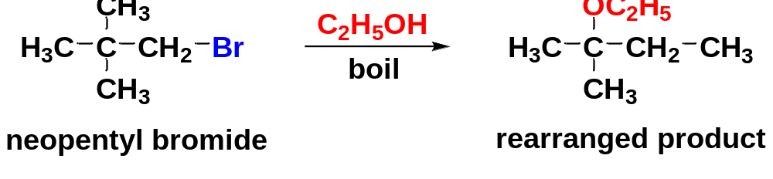
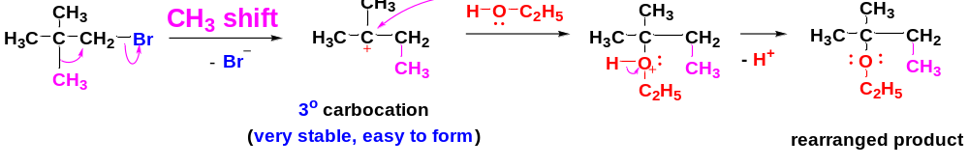
Sometimes, rearranged product is the result of a methyl shift or an alkyl shift.
Mechanism:
rearrangement
In general, we should expect rearrangements in reactions involving carbocations whenever a hydride shift or an alkyl shift can form a more stable carbocation.
Most rearrangements convert 2º (or incipient 1º) carbocations to 3º (or resonance-stabilized) carbocations.

Slide 27
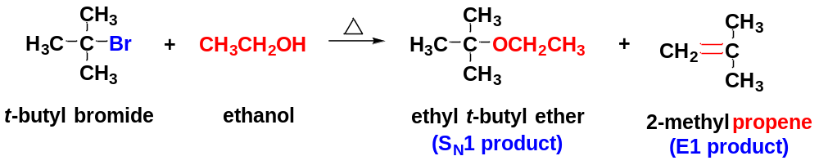
7-8 First-Order Elimination: The E1 Reaction
An elimination involves the loss of two atoms or groups from the substrate, usually with formation of a π bond.
Elimination reactions frequently accompany and compete with substitutions. By varying the reagents and conditions, we can often modify a reaction to favor substitution or to favor elimination.
Depending on the reagents and conditions used, an elimination might be an E1 or E2 process.
7-8-1 Mechanism and kinetics of the E1 reaction

Slide 28
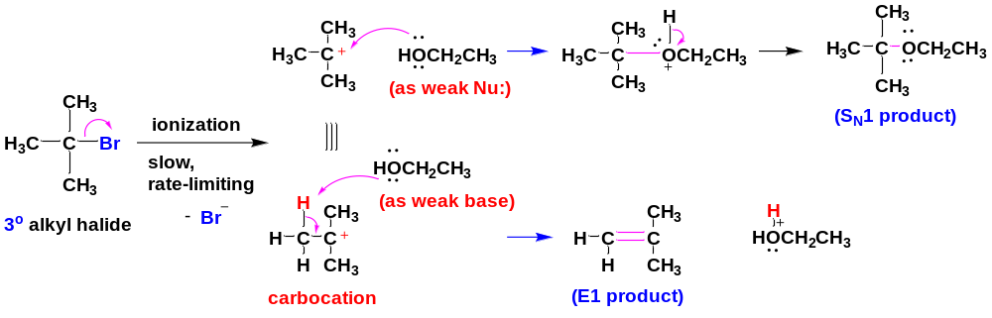
Ethanol serves as a nucleophile in the substitution and as a base in the elimination.
fast
step 1 (key step): Ionization to form a carbocation
step 2 (fast): Basic attack by the solvent abstracts a proton to give an alkene.
The abbreviation of E1 stands for Elimination, unimolecular. The slow step of E1 reaction is the same as in the S_{N}1 reaction: unimolecular ionization to form a carbocation.
The E1 reaction requires ionization to a carbocation intermediate, so it follows the same order of reactivity:
3º > 2º >> 1º alkyl halides
Like other carbocation reactions, the E1 may be accompanied by rearrangement.

Slide 29
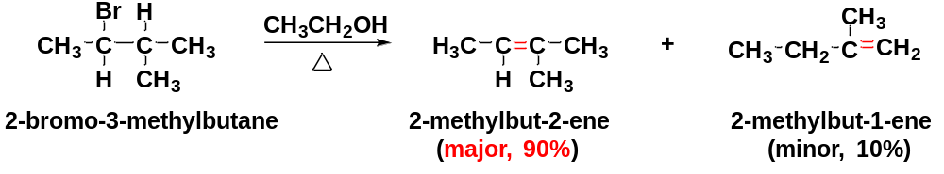
7-8-2 Positional orientation of Elimination: Zaitsev’s rule
Many compounds can eliminate in more than one way, to give mixtures of products. In many cases, we can predict which elimination product will predominate.
In most Eliminations where there are two or more possible elimination products, the product with the most substituted double bond (the most stable alkene) will predominate.
This principle is called Zaitsev’s rule, and reactions that give the most substituted alkene are said to follow Zaitsev orientation.
(trisubstituted alkene)
(disubstituted alkene)

Slide 30
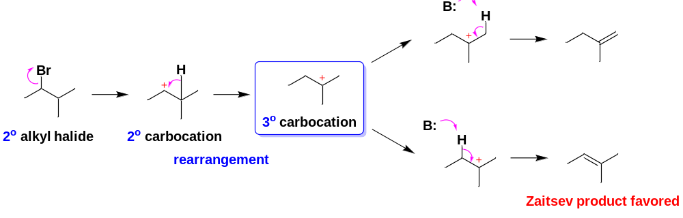

Zaitsev’s rule: In elimination reactions, the most substituted alkene usually predominates. This order of preference is the same as the order of stability of alkenes.
Relative stability of alkenes:

Slide 31


7-9 Second-Order Elimination: The E2 Reaction
Elimination can also take place under second-order conditions with a strong base present, following the E2 mechanism.
Backside attack is not allowed due to steric hindrance of the 3º alkyl halide: S_{N}2 mechanism is forbidden
X
Methoxide ion as a strong base as well as a strong nucleophile attacks the alkyl halide faster than the halide can ionize to give a carbocation: S_{N}1 and E1 mechanism are impossible under strongly basic and nucleophilic conditions.

Slide 32


7-9-1 Mechanism and Kinetics of the E2 reaction
Mechanism: E2 takes place in one step, with bromide leaving as the base is abstracting a proton from the alkyl halide.
β-H is slightly acidic, due to the presence of the electron-withdrawing group Br bonded to the α-C
In the E2 reaction, methoxide reacts as a base rather than as a nucleophile
β
α
In the general mechanism of the E2 reaction, a strong base abstracts a proton on a carbon atom adjacent to the one with the leaving group. As the base abstracts a proton, a double bond forms and the leaving group leaves.

Slide 33


The order of reactivity for alkyl halides in E2 reactions : 3º > 2º > 1º alkyl halides.
This reactivity order reflects the greater stability of highly substituted double bonds. Elimination of a tertiary halide gives a more substituted alkene than elimination of a secondary halide, which gives a more substituted alkene than a primary halide.
E2 commonly results when a strong base is used with a poor SN2 substrate such as 3o or hindered 2o alkyl halide.
7-9-2 Positional orientation of E2: Zaitsev’s rule
Positional orientation in the E2: in the E2, if there are two or more possibilities, Zaitsev’s rule predicts which of the possible products will be the major product: the most substituted alkene.

Slide 34

7-9-3 Stereochemistry of the E2 reactions: anti-coplanar arrangement
E2 takes place in one step, with halide leaving as the base is abstracting a proton from the alkyl halide substrate . In the conformation of the substrate for elimination, when the β-H and the halogen are anti to each other, it is called anti-coplanar conformation.
The anti-coplanar conformation is most commonly seen in E2 reactions.

Slide 35


Slide 36



7-9-4 E2 Reactions in Cyclohexane Systems
Nearly all cyclohexanes are most stable in chair conformations.
In the chair, all the C-C bonds are staggered, and any two adjacent carbon atoms have axial bonds in an anti-coplanar conformation, ideally oriented for the E2 reactions.
On any two adjacent carbon atoms, one has its axial bond pointing up and the other has its axial bond pointing down. These two bonds are trans to each other. If the β-H and the leaving group can get into such an arrangement, an E2 elimination can take place on this chair conformation.

